Slide 1

Exploring Hyperdimensional Associative Memory
Mohsen Imani, Abbas Rahimi, Deqian Kong, Tajana Rosing, and Jan M. Rabaey
CSE Department, UC San Diego
EECS Department, UC Berkeley

Slide 2
Outline
Background in HD Computing
Application Example: Language Recognition
Exploring HAM Designs and Optimizations
Digital HAM (D-HAM)
Resistive HAM (R-HAM)
Analog HAM (A-HAM)
Experimental Results
Summary

Slide 3
Brain-inspired Hyperdimensional Computing
Hyperdimensional (HD) computing [P. Kanerva, Cognitive Computation’09]:
Emulation of cognition by computing with high-dimensional vectors as opposed to computing with numbers
Information distributed in high-dimensional space
Supports full algebra
Superb properties:
General and scalable model of computing
Well-defined set of arithmetic operations
Fast and one-shot learning (no need of back-prop)
Memory-centric with embarrassingly parallel operations
Extremely robust against most failure mechanisms and noise
Overcome low SNR, and large variability in both data and platform to perform robust decision making and classification improving both performance and energy efficiency!

Slide 4
What Are Hypervectors?
Distributed pattern–based data representations and arithmetic in contrast to computing with numbers!
Hypervectors are:
high-dimensional (e.g., 10,000 dimensions)
(pseudo)random with i.i.d. components
holographically distributed (i.e., not microcoded)
Hypervectors can:
use various coding: dense or sparse, bipolar or binary
be combined using arithmetic operations: multiplication, addition, and permutation (MAP)
be compared for similarity using distance metrics, e.g., Hamming distance

Slide 5
Mapping to Hypervectors
Each symbol is represented by a 10,000−D hypervector chosen at random:
A = [−1 +1 −1 −1 −1 +1 −1 −1 ...]
B = [+1 −1 +1 +1 +1 −1 +1 −1 ...]
C = [−1 −1 −1 +1 +1 −1 +1 −1 ...]
D = [−1 −1 −1 +1 +1 −1 +1 −1 ...]
...
Z = [−1 −1 +1 −1 +1 +1 +1 −1 ...]
Every letter hypervector is dissimilar to others, e.g., ⟨A, B⟩ = 0
This assignment is fixed throughout computation
Item Memory (iM)
“a”
A
8
10,000

Slide 6
Example Problem: Language Recognition
Identify the language from a stream of letters (n-grams)
Train with a megabyte of text from each of 21 EU languages
Test with 1,000 sentences from each (from independent source)
Train text: “ik wil hier en daar een greep uit de geschiedenis doen en ga over...”
Test sentence: “daher stimme ich gegen anderungsantrag welcher”
Item Memory
Item Memory
Letter hypervector
10,000-D
Letter hypervector
10,000-D
Encoding:
MAP operations
Encoding: MAP operations
Language hypervector
10,000-D
Text hypervector
10,000-D
Associative Memory
Associative Memory
Identified language
dutch
21×10,000-D learned language hypervectors

Slide 7
Its Algebra is General: Architecture Can Be Reused
Letter
S₁
S₂
S₃
S₄
8-bit
5-bit
5-bit
5-bit
5-bit
Item memory
Item memory
Item memory
Item memory
Item memory
10K-bit
10K-bit
10K-bit
10K-bit
10K-bit
Encoder: MAP operations
Encoder: MAP operations
10K-bit
10K-bit
Associative memory
Associative memory
Common
denominator
for searches
Languages: 21 classes
Hand gestures: 5 classes
Applications | n-grams | HD | Baseline
Language identification [ISLPED’16] | n=3 | 96.7% | 97.9%
Text categorization [DATE’16] | n=5 | 94.2% | 86.4%
EMG gesture recognition [ICRC’16] | n∈ [3,5] | 97.8% | 89.7%
EEG brain-machine interface [BICT’17] | n∈ [16,29] | 74.5% | 69.5%

Slide 8
Contributions
Facilitate energy-efficient, fast, and scalable comparison of large patterns stored in memory :
Digital CMOS-based HAM (D-HAM): Modular scaling
Resistive HAM (R-HAM): Timing discharge for approximate distance computing
Analog HAM (A-HAM): Faster and denser alternative
For a moderate accuracy of 94%:
Approximation techniques: sampling, voltage overscaling, bit width optimization, current-based search and comparators
R-HAM improves the energy-delay product by 9.6×
A-HAM improves the energy-delay product by 1347× compared to D-HAM

Slide 9
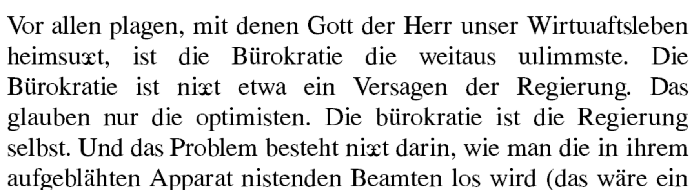
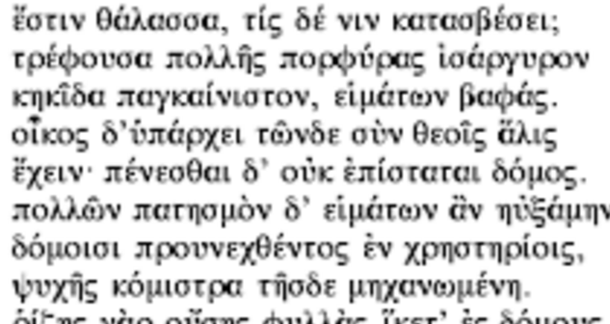
HAM for Language Recognition
Structure of hyperdimensional associative memory (HAM): Comparing D=10,000 bits

Slide 10
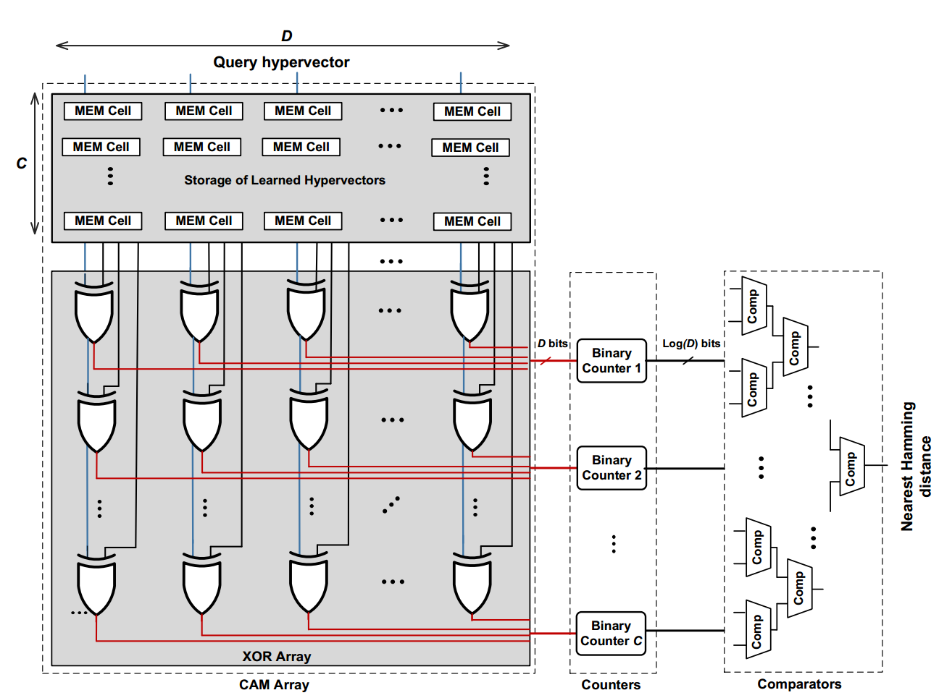
D-HAM: Digital HAM
XOR array (D×C): bit-level comparison of query hypervector with all “learned” hypervectors
Counters (C): counting the number of mismatches for every row
Comparators: finding a row with minimum Hamming distance

Slide 11
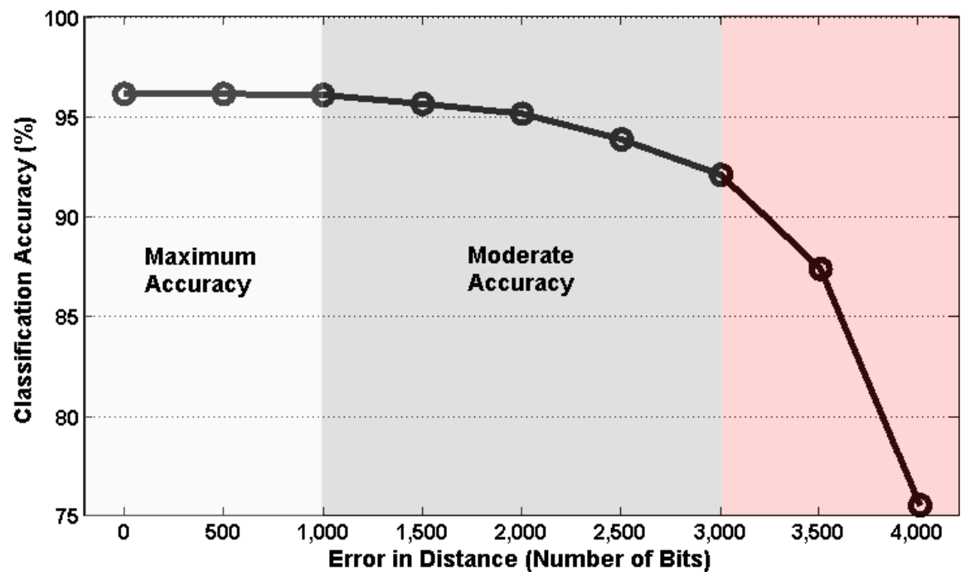
DHAM Optimization: Sampling
Language classification accuracy
Maximum accuracy: 96.4%
Moderate accuracy: up to 4% lower accuracy than maximum
Sampling: smaller dimensionality (d < 10,000)
Utilize HD robustness
d=9,000 bits: 7% energy saving at maximum accuracy
d=7,000 bits: 22% energy saving at moderate accuracy

Slide 12
R-HAM: Resistive HAM
2T-2R CAM Array: No XOR!
CAM Array: M blocks each with D/M bits (max 4 bits)
CAM blocks generate a non-binary code
Parallel counters to compute distance among partial CAM blocks

Slide 13
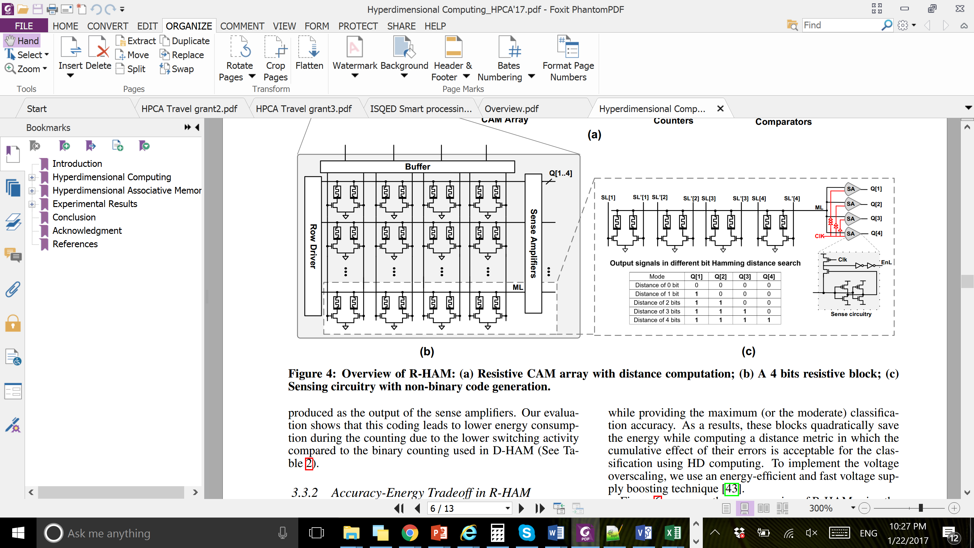
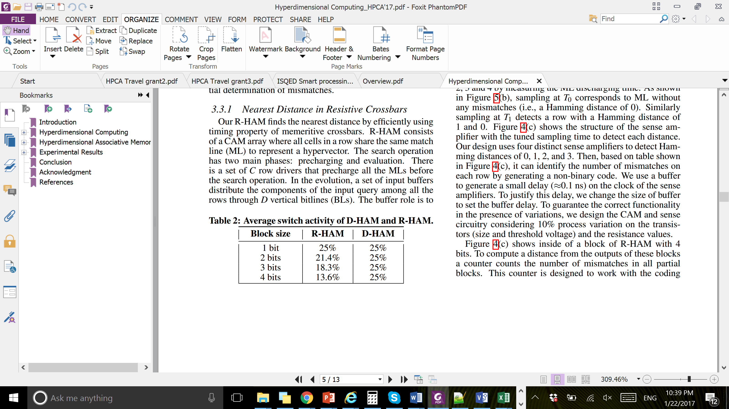
R-HAM Optimizations: Switching Activity
Explore block size: 1 to 4 bits
Non-binary code to represent the accumulative distances:
Q[1]= 1 for “Distance 1 bit”
Q[2]= 1 for “Distance 2 bits”
Q[3]= 1 for “Distance 3 bits”
Q[4]= 1 for “Distance = 4 bits”
Lower switching activity in CAM, counters, and comparators

Slide 14
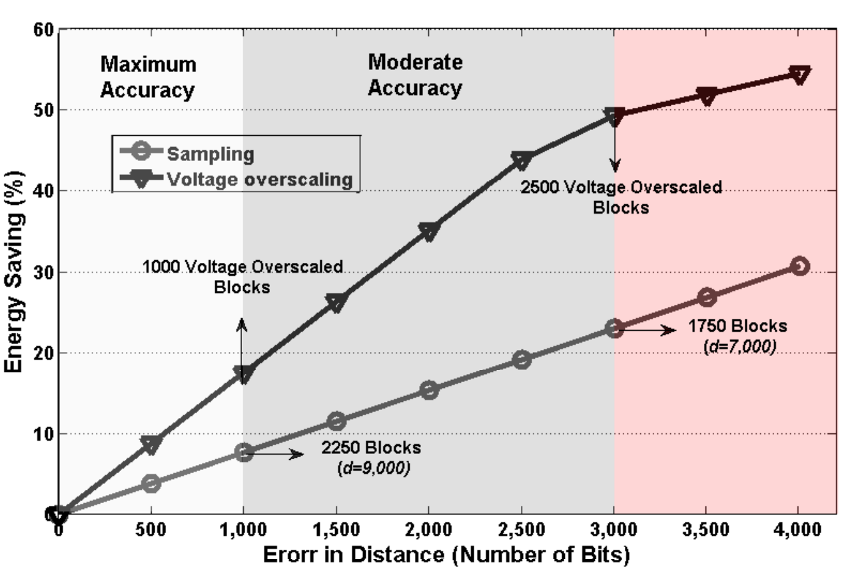
R-HAM Optimizations: Voltage Overscaling
Voltage overscaling for blocks rather than blind sampling
Target Accuracy | Energy Saving: Sampling | Energy Saving: Voltage Overscaling
Maximum | 9%: 250 blocks off | 18%: 1000 blocks at 780mV
Moderate | 22%: 750 blocks off | 50%: 2500 blocks at 780mV

Slide 15
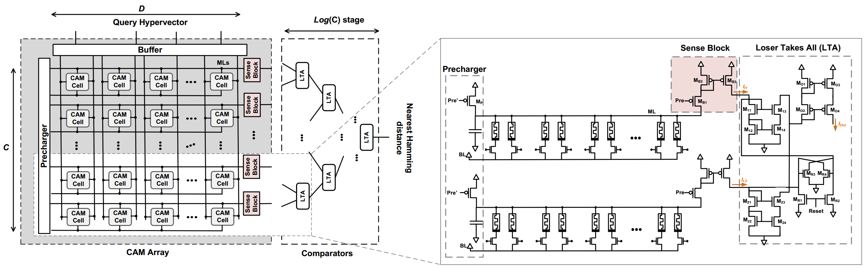
A-HAM: Analog HAM
Current-based analog search in CAM
Lowest discharging current → closest distance row
Loser Taken All (LTA): finds the lower current among two inputs
Faster and denser alternative
I₁
LTA
I₁ if I₂> I₁
I₂ if I₁> I₂
I₂

Slide 16
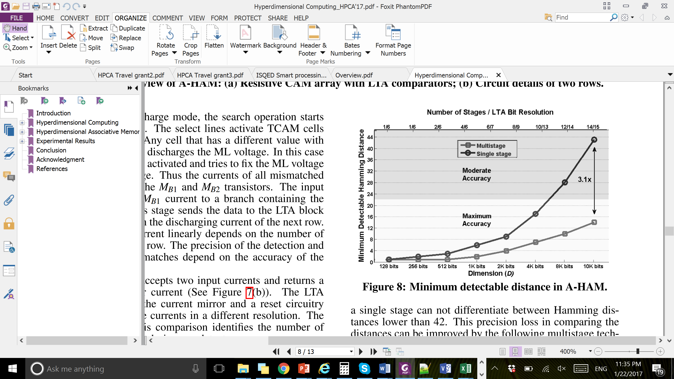
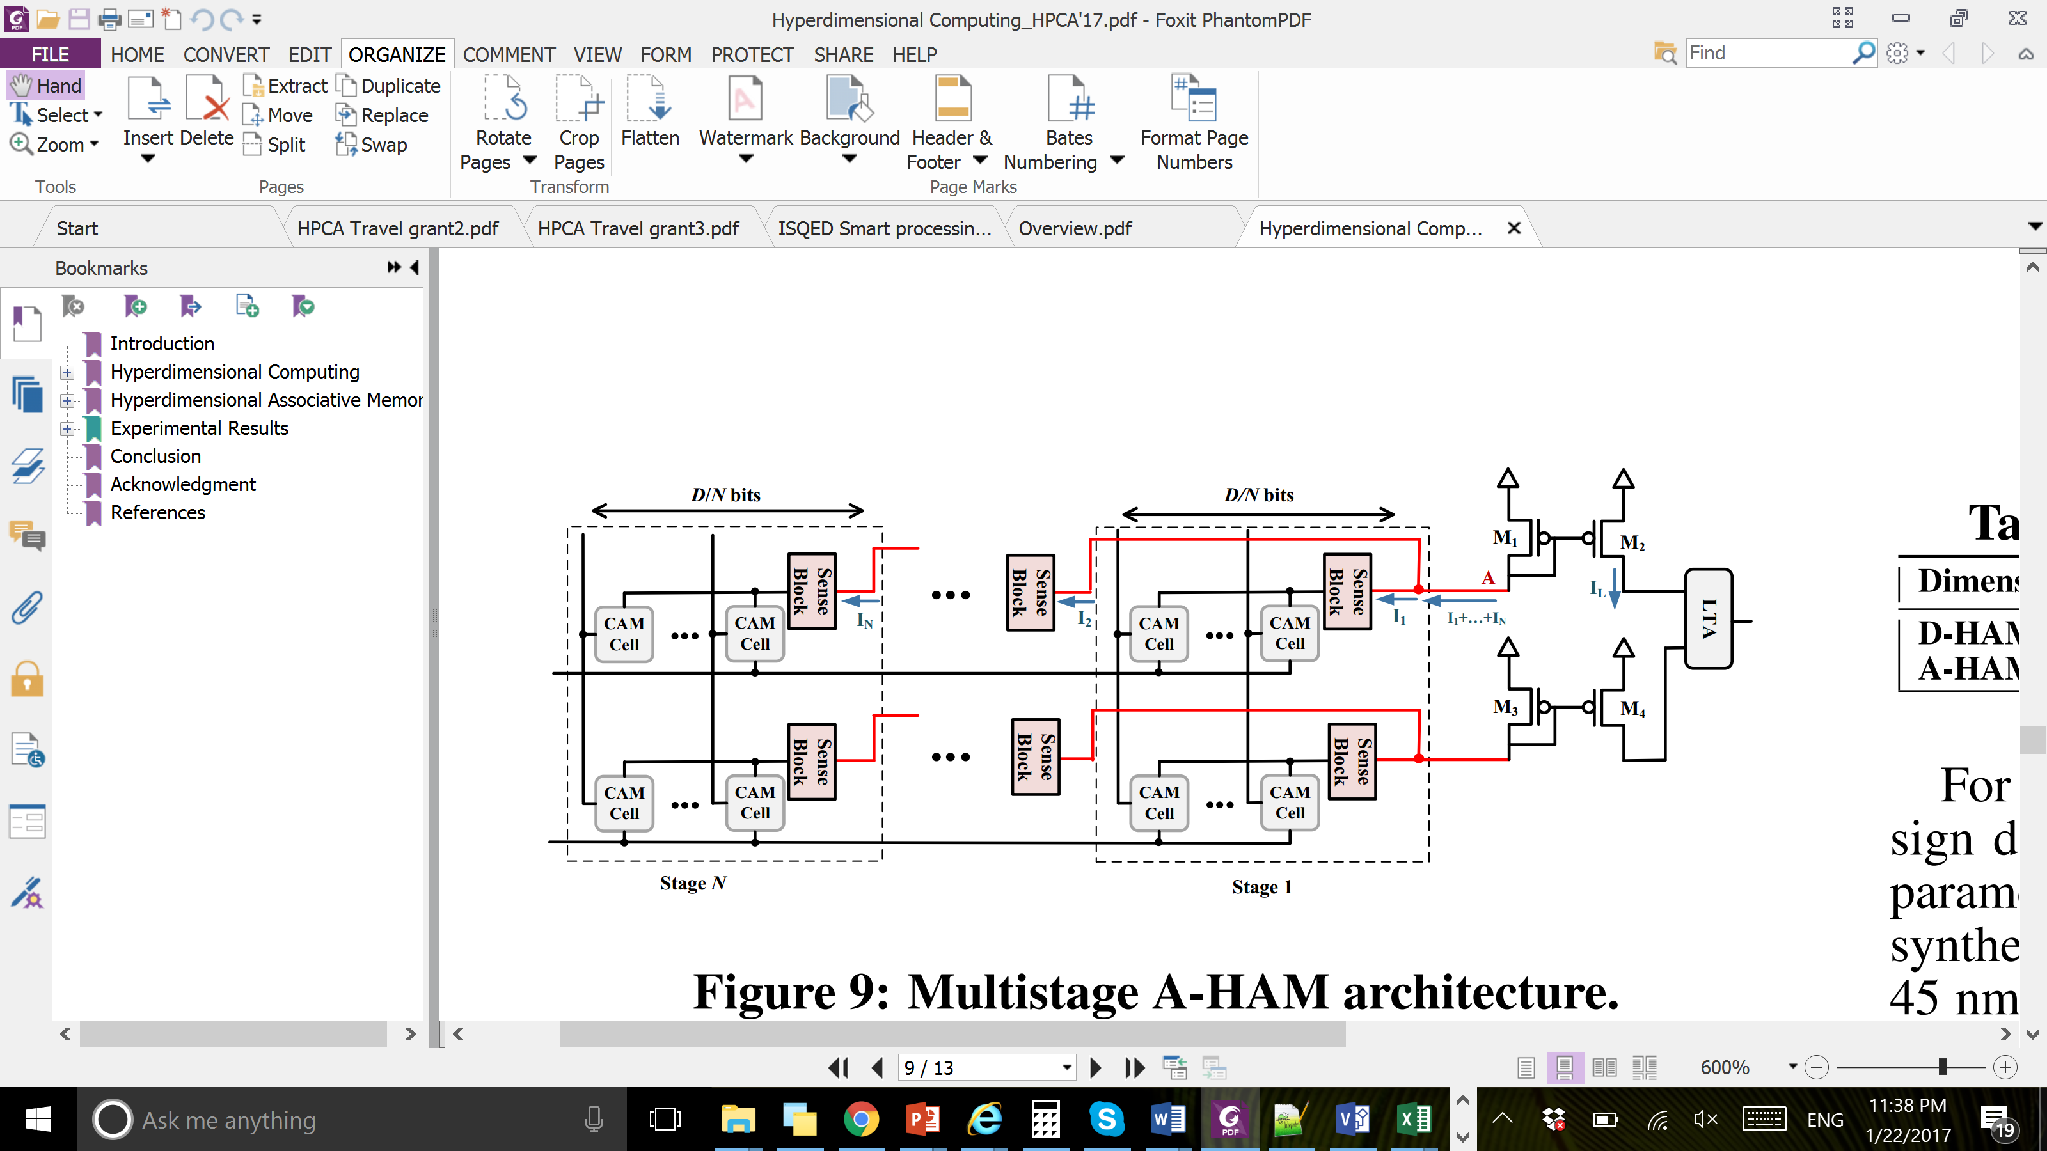
Multistage A-HAM
Discharging current saturates for large D
Cannot detect small distances
Split the search operation to multiple shorter stages
Improves the minimum detectable Hamming distance by 3.1X

Slide 17
Experimental Results
TSMC’s 45 nm, LP process, high VTH cells
Normalized energy-delay-product to D-HAM
Maximum accuracy: R-HAM 7.3X and A-HAM 746X
Moderate accuracy: R-HAM 9.6X and A-HAM 1347X
Area compared to D-HAM
R-HAM is 1.4X and A-HAM is 3X lower area
Increasing dimensionality by 20X:
D-HAM: ~8.3X energy and 2.2X delay increase
R-HAM: ~8.2X energy and 2.0X delay increase
A-HAM: ~1.9X energy and 1.7X delay increase
Increasing classes by 15X:
D-HAM: ~12.6X energy and 3.5X delay increase
R-HAM: ~11.4X energy and 3.4X delay increase
A-HAM: ~15.9X energy and 4.4X delay increase
A-HAM is sensitive to >5% voltage variability

Slide 18
Summary
HD computing: manipulating and comparing large patterns stored in memory
Explored digital, resistive, and analog HAM designs by sampling, voltage overscaling, bit width optimization, current-based search and comparators
For a moderate accuracy of 94%:
A-HAM improves EDP by 1347×
A-HAM has 3X lower area
Multi-stage A-HAM scales with higher dimensionality and linearly with number of classes
But sensitive to >5% voltage variability

Slide 19


Acknowledgment
This work was supported in part by Systems on Nanoscale Information fabriCs (SONIC), one of the six SRC STARnet Centers, sponsored by MARCO and DARPA.

